Slide 1
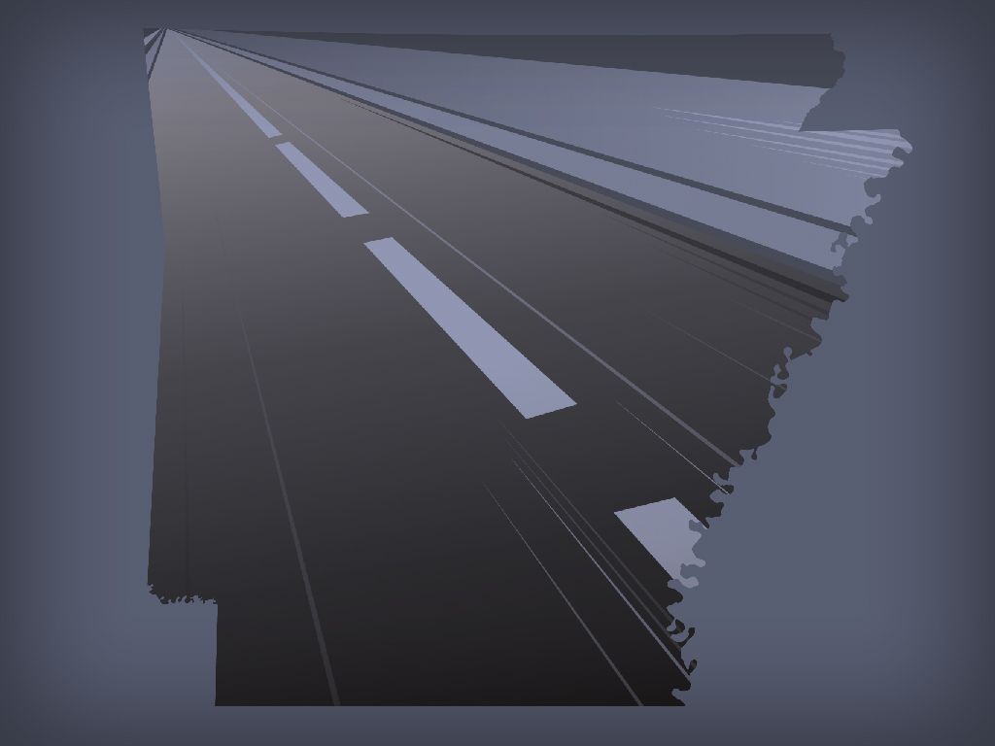

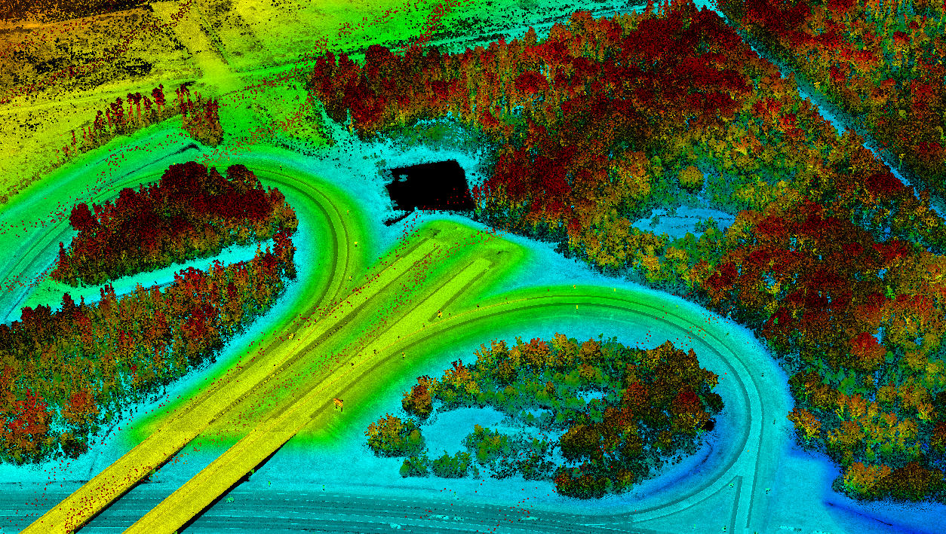
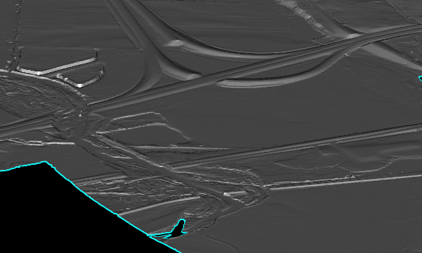
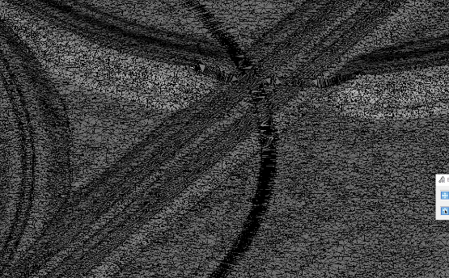
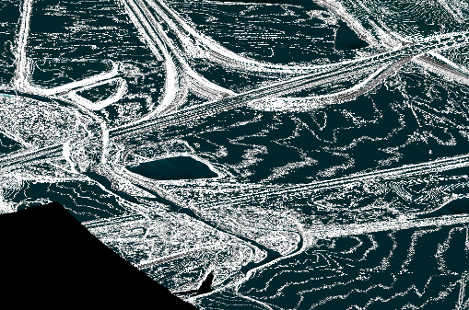
David Hall, P.E., P.S.
Division Head of Surveys
Cliff Mefford, RPP, CP
Quantum Geospatial
LiDAR for I-49 Terrain Modeling
Transportation Research Conference
August 16, 2019

Slide 2


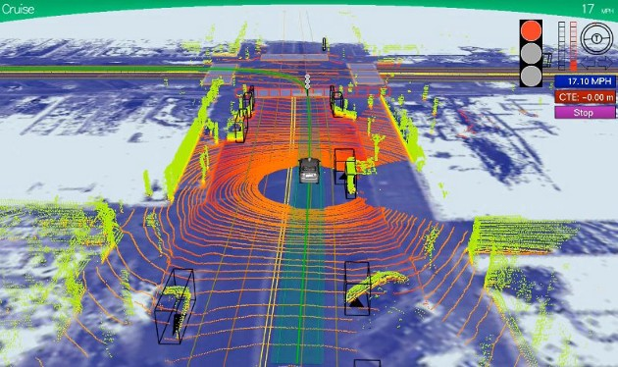
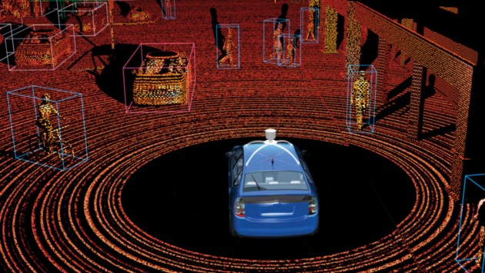
Future of LiDAR
Why is LiDAR used in self-driving cars?
Huge 3D maps! (it’s original application)

Slide 3
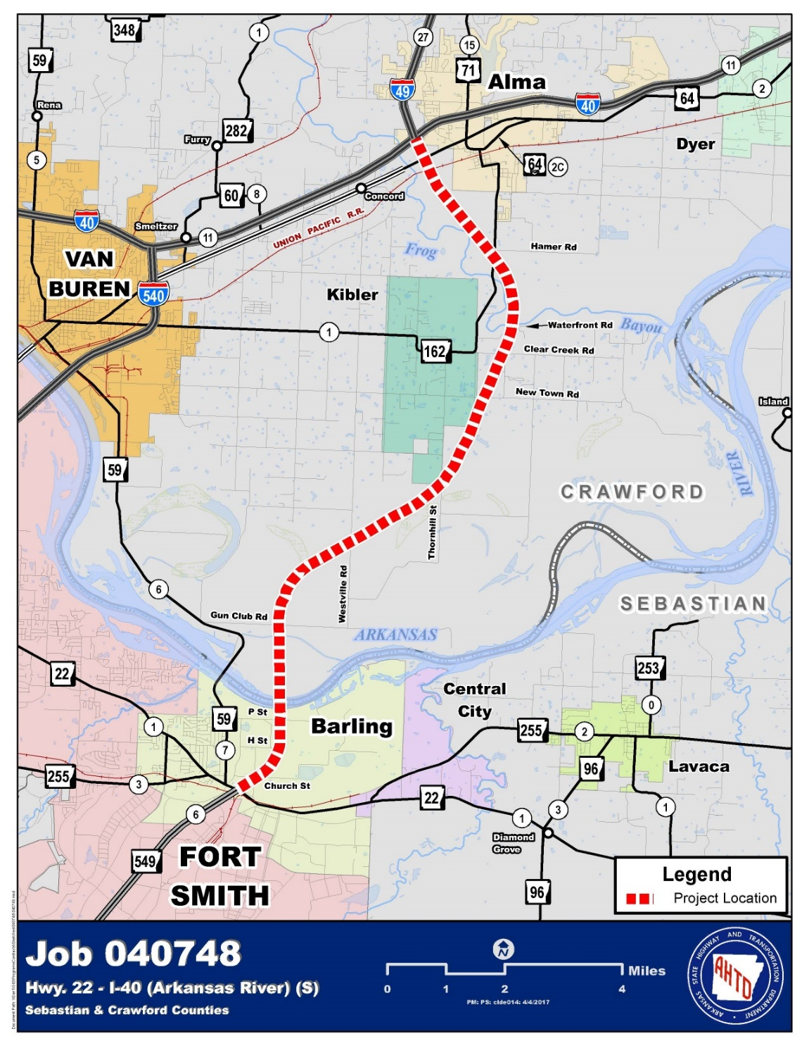
Job 040748, Hwy. 22 – I-40 (Arkansas River) (S)
Included in 2016-2019 STIP for PE and ROW purchase
Original line selected in 1997 EIS
13.56 miles, includes bridge over Arkansas River

Slide 4
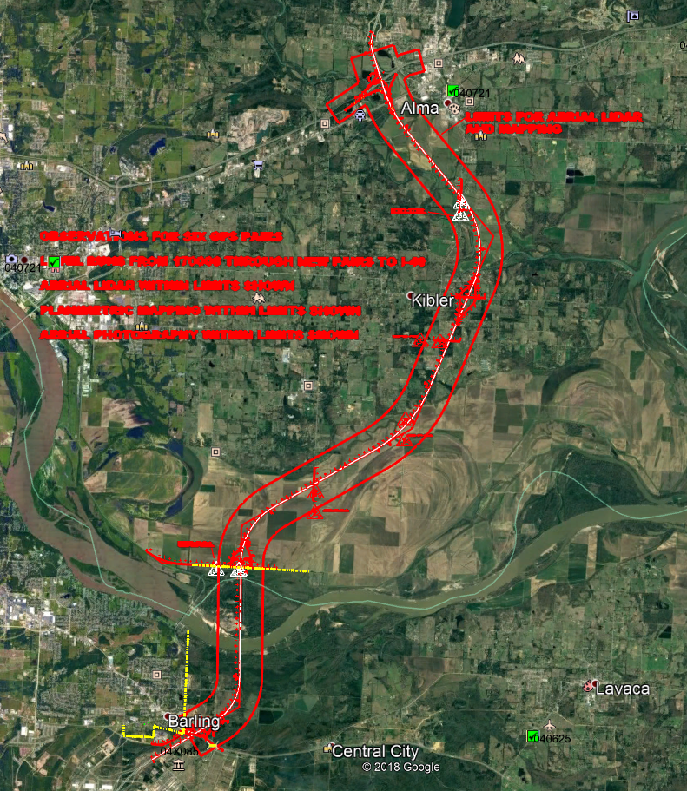
Project Challenges
  Constrained timeline
  New location
  Dense vegetation
  Length

Slide 5
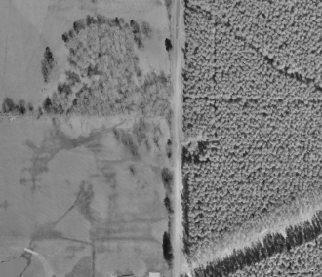
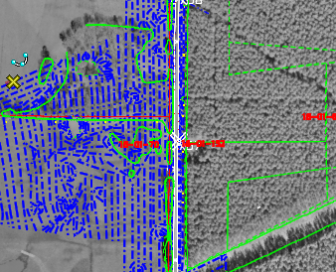
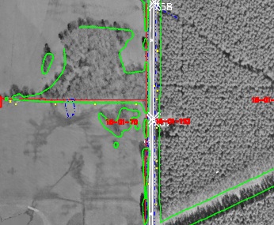
Typical Project Timeline for Mapping
  Photogrammetric mapping
  Very efficient for mapping large projects
  But….
  Requires four to six months for feature extraction
  Often still areas that require field surveys
Breakline Features
Aerial Photography
Planimetric Features

Slide 6
Advantages of LiDAR
  Eliminates the need for most breaklines
  Effective at obtaining surface information in vegetated areas
  Minimize intrusion on private properties
  Cost effective for large area mapping projects
  Previous experience with CA0602 and CA0608

Slide 7
Requirements
  Aerial LiDAR
  Aerial Photography
  0.1’ vertical accuracy
  40 points/sq. meter
  Ground Truthing

Slide 8
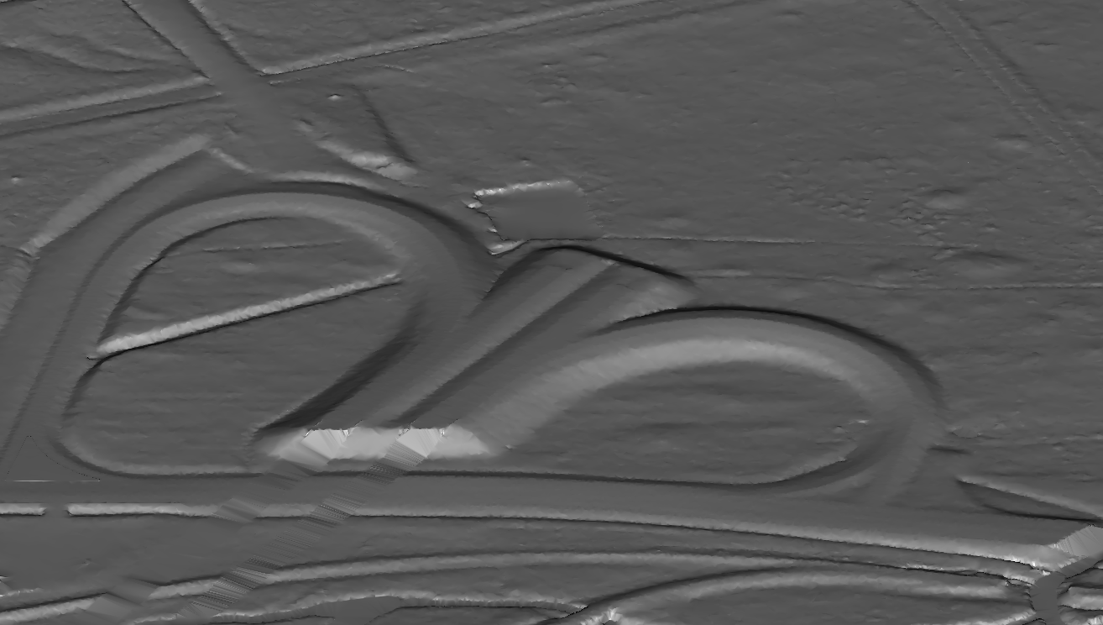
Results

Slide 9
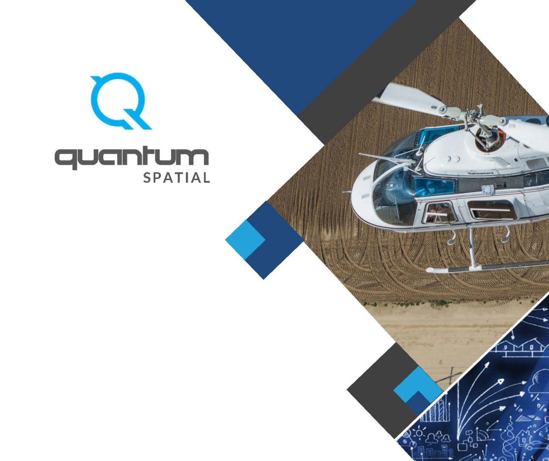
I-49 Technical Approach

Slide 10
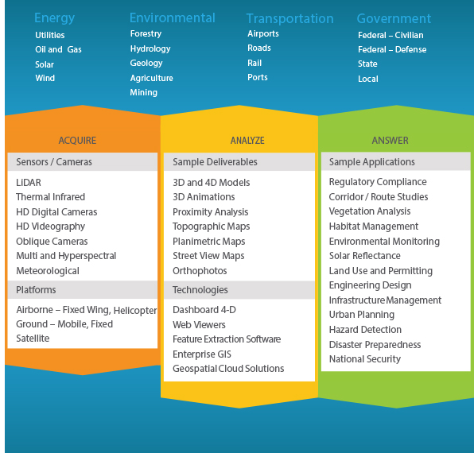


Quantum Spatial Corporate Overview
Notes:
Quantum Spatial is North America’s largest full-service geospatial solutions company. Our comprehensive capabilities encompass the acquisition, analysis, integration, and management of geospatial data. We offer a diverse portfolio of advanced imaging and remote sensing technologies, backed by powerful modeling, visualization, and GIS tools. Our geospatial services have strategic value in countless applications—from habitat assessment and land use planning to regulatory compliance, engineering design, and disaster preparedness. We have successfully delivered billions of acres of geospatial data in projects for energy, transportation, environmental, and government clients.

Slide 11
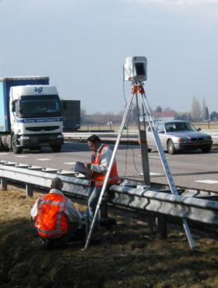
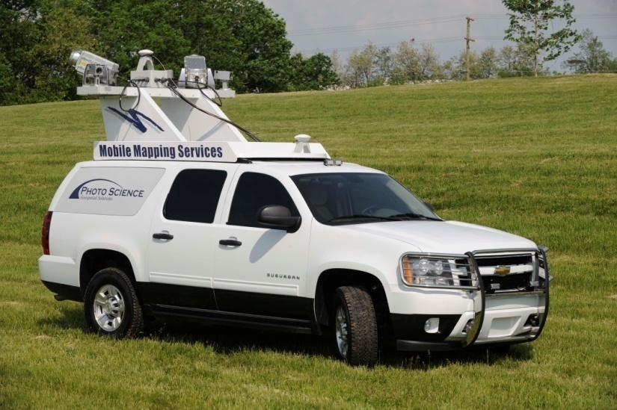
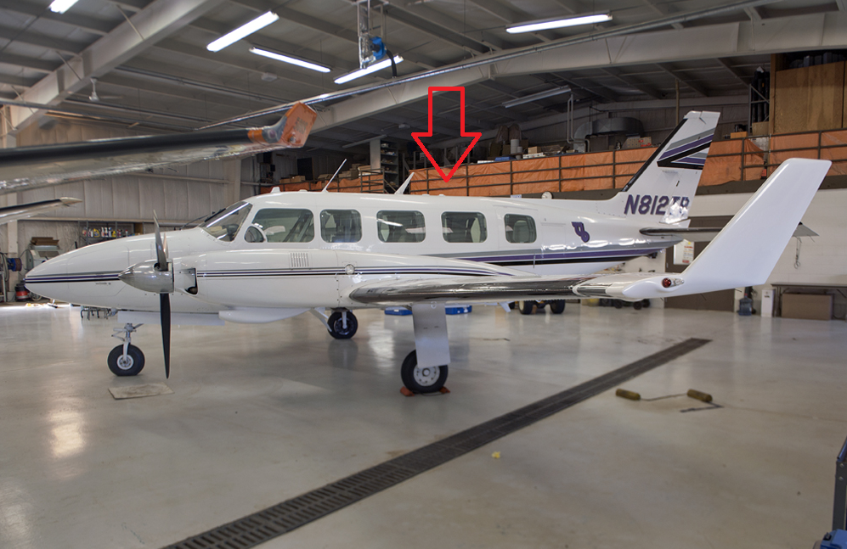
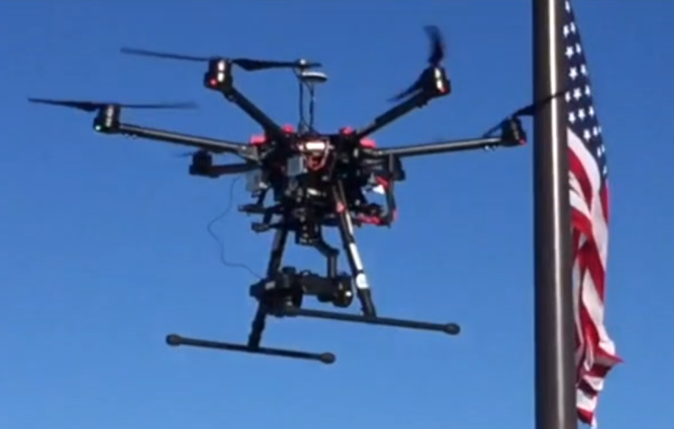
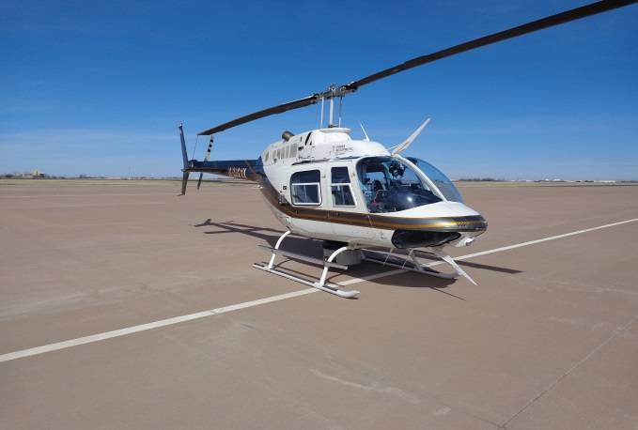
Formats
Image Acquisition
RGB and IR
Multispectral
Thermal
LiDAR Acquisition
Mobile LiDAR
Terrestrial LIDAR
TopoBathy LIDAR
UAS LiDAR
Platforms
Terrestrial
Mobile
Aerial Fixed Wing
Helicopter
UAV

Slide 12



Summary of Work
For the IH 49 project, Quantum Spatial acquired aerial LiDAR data from a helicopter platform using a Riegl 480I full waveform laser scanner. Data were acquired with an approximate acquisition density of 40 points per square meter. Images of the project area were obtained using a Vexcel / Microsoft UltraCAM Falcon , large format digital mapping camera.
From this LiDAR data and digital photography, Quantum Spatial provided:
Planimetric mapping for output at a horizontal scale of 1"=50'
LiDAR Digital Terrain Model (DTM) data
Contours at 1’ intervals
Digital orthophotos intended for viewing and plotting at 1”=50’ scale, represented with a pixel ground sample distance (GSD) of 0.25’.

Slide 13
Summary of Work
Project Area
New mapping was provided for an approximately 7,200-acre new alignment of I-49 near Fort Smith, Arkansas. The approximately 14.3 mile alignment began near the intersection of I-49 and Highway 22 near Barling, Arkansas and continued north to the intersection of I-49 and I-40 near Alma, Arkansas.
Quality Standards
This project was designed to conform to the American Society for Photogrammetry Class I Accuracy Standards.

Slide 14
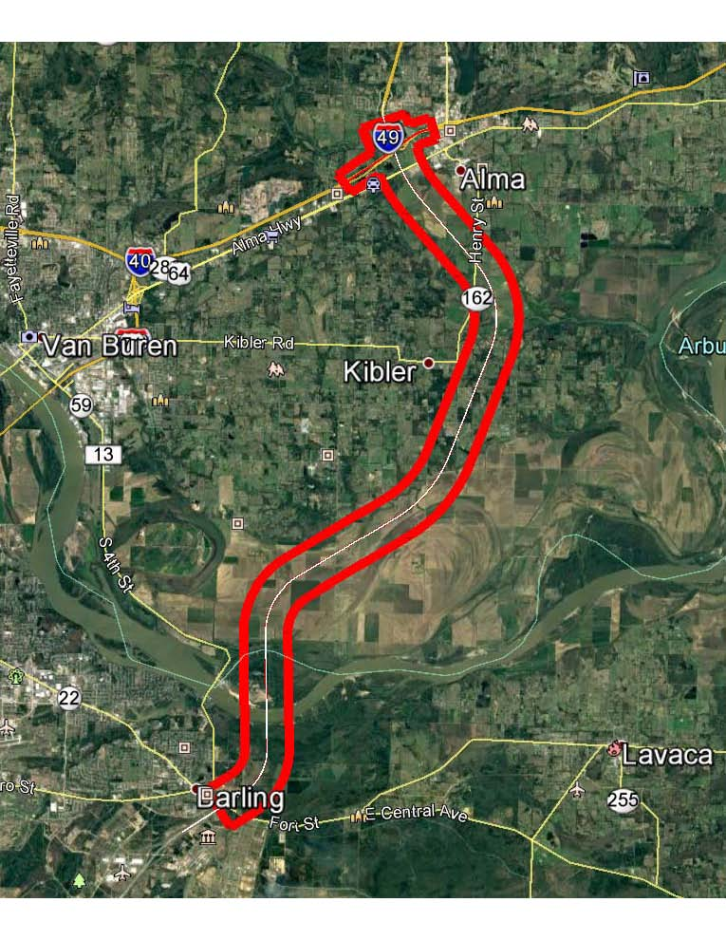
Project Area of Interest (AOI)

Slide 15
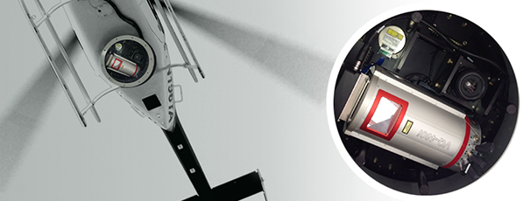
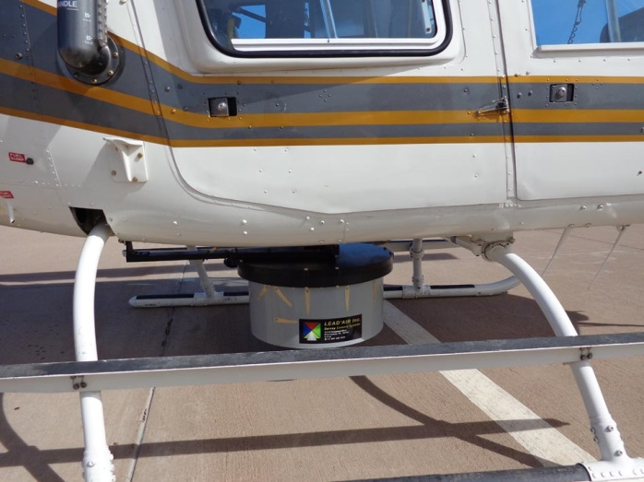
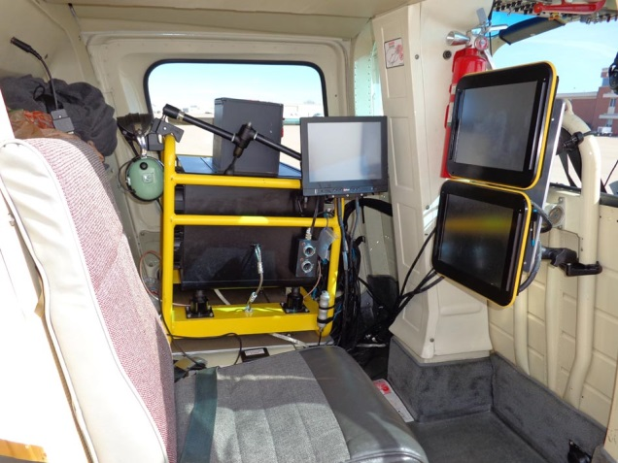
Acquisition LiDAR
Reigl 480i LiDAR Sensor – 550khz
1,000 feet – Approx. 40 ppm
Trimble AP50 Inertial POS system collected the orientation and position of the airborne sensor

Slide 16
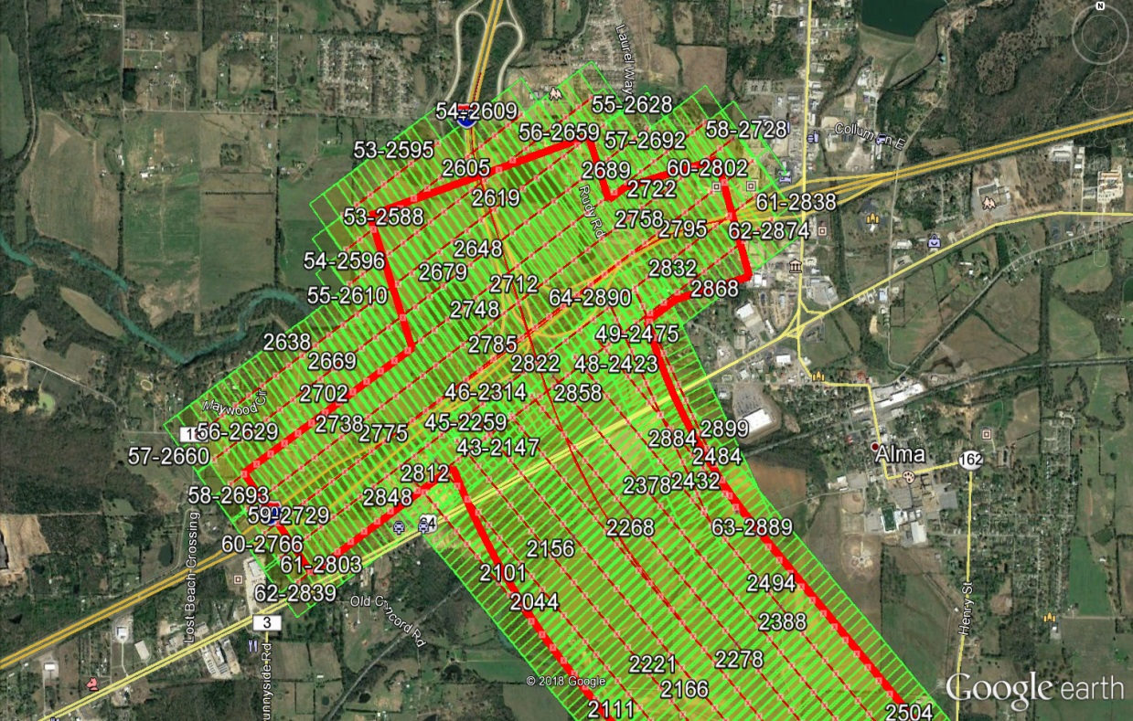
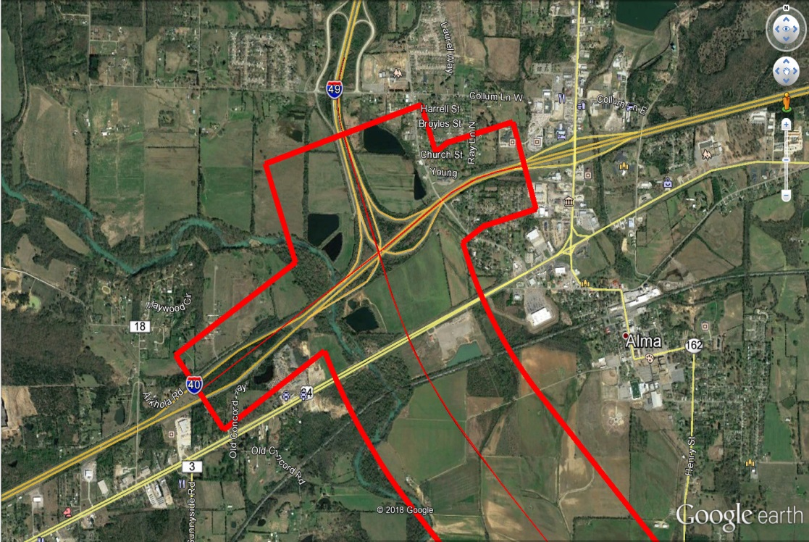
LiDAR Acquisition
IH 40 and IH 49 Interchange
Up to 9 parallel flight lines
50% overlap between lines
40 points per square meter
3.71 points per square foot
43,560 * 3.71 = 161,607 pts per acre
Airborne Control (ABGPS and IMU)

Slide 17
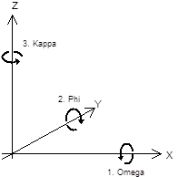
LiDAR Pulse - Rotating Prism
Sensor Orientation - Ground Coordinate
Sensor Orientation Omega Kappa Phi, and Position X, Y and Z

Slide 18
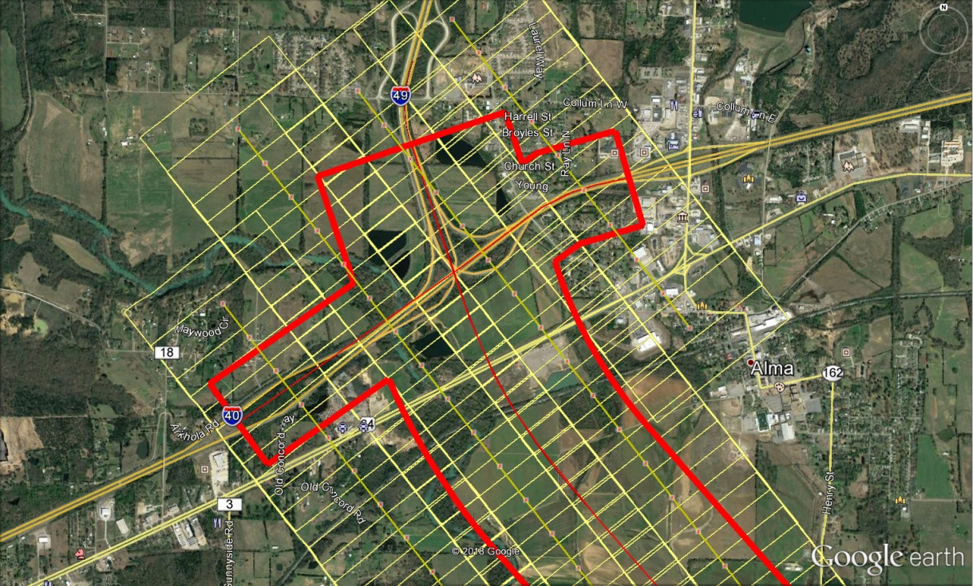
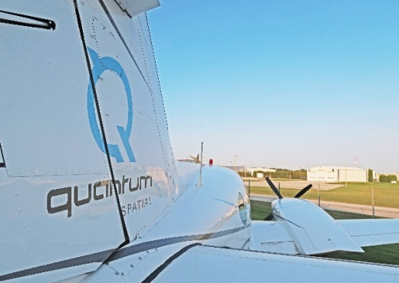
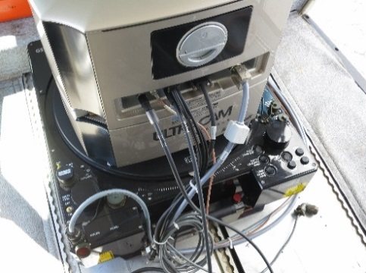
Image Acquisition
IH 40 and IH 49 Interchange
Two parallel flight lines
Four Parallel flight lines north end
6cm Acquisition
30% overlap between lines
Sixteen Flight Lines
277 frames
261 Stereo Models
Airborne Control (ABGPS and IMU)
Image data were acquired with the Vexcel UltraCam Falcon digital photogrammetric mapping camera

Slide 19
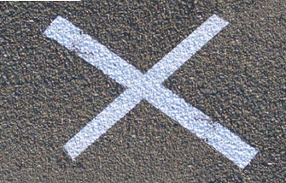
Project Control
Airborne Control
Airborne control (ABGPS) and internal measurement Unit (IMU) data were acquired during LiDAR and Image Acquisition
Ground Control
Quantum Spatial specified that seventy (70) new ground control points will be required for the proposed mapping.
Aerial panels were set at each of the specified control locations prior to the flight and maintaining the targets until QSI has completed the LiDAR and image acquisition.
Control was provided in the form of three-dimensional planar coordinates, in digital form, indicate the coordinate system, horizontal and vertical datum, unit of measure
Two (2) GPS base stations shall be require for differential correction of the airborne control
Aerial Triangulation (AT)
The Quantum Spatial performed AT to determine the orientation, omega, kappa, phi and the X,Y,Z of each frame of project photography.
Quantum Spatial utilized a combination of direct geo-positioning from ABGPS /IMU navigation systems, ground survey to perform and block bundle adjustment to arrive at an AT solution which is required for feature collection and orthophoto rectifications

Slide 20
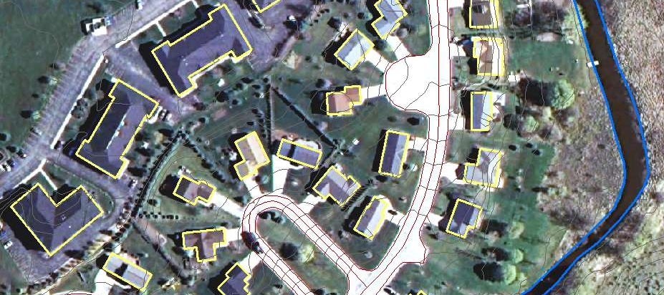
Photogrammetric Mapping
Planimetric base maps, at a scale of 1”=50’ were digitally compiled from the aerial photography using softcopy stereoplotters. Base map detail was compliant with the Arkansas Department of Transportation’s aerial mapping feature tables and standards

Slide 21
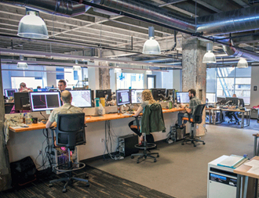
LiDAR Processing
LiDAR data were processed and calibrated to project datum. The LiDAR solution was verified to the project ground control
The LiDAR data were classified to determine the Bare Earth Model (BEM)
Quantum Spatial perform a model key point analysis of the LiDAR data set, a process that reduces the density points in the data set while maintaining data integrity.
Quantum Spatial collected break-line data for the roadway centerline, road edges, top and toes of drainage as required to properly define the terrain surface. Break-line data were collected from the stereo photography
Break-line data were draped over the LiDAR BEM for elevation assignment
Please note that bridge surfaces are not a part of the terrain surface. During the LiDAR processing, bridge surface data were moved to a bridge surface file. Bridge edge feature data, collected in the planimetric mapping and draping process are also moved to the bridge surface files and used as break lines for the bridge surfaces.

Slide 22
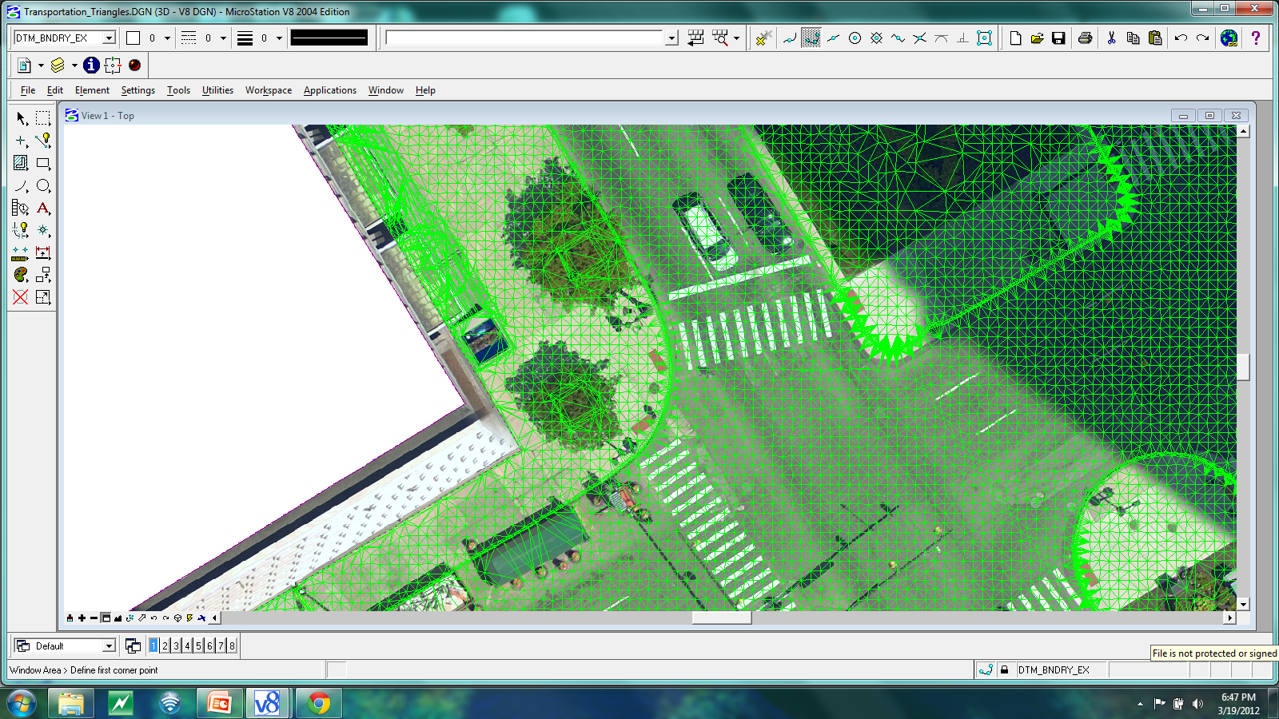
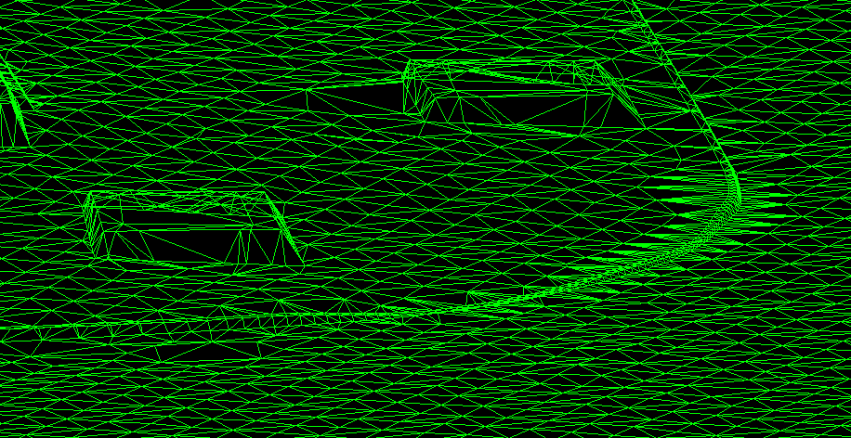
LiDAR Curb Modeling
Gutter, Top and Back of Curb breaklines were developed from the LiDAR BEM
Break-line data and curb break line data were merged with the LiDAR BEM to create a digital terrain model (DTM) of the project surface.
From the DTM data, a triangular irregular network (TIN) was constructed and used to determine contours at 1’ intervals.

Slide 23
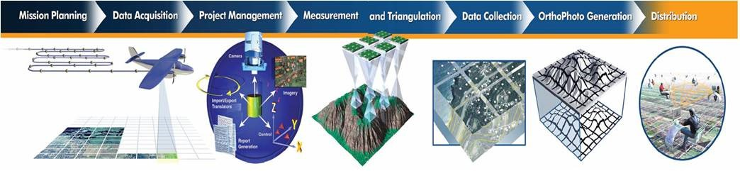
Orthophoto Development
Quantum Spatial oriented the raw digital imagery in blocks, then used the results of camera orientation parameters (omega, kappa and phi, X,Y and Z from AT) and a bare earth model (BEM) from the LIDAR data to perform an orthophoto rectification of each individual frame of the project photography.
The rectifications were performed using a transformation algorithm to convert every pixel in the image from a sample/line location to an X, Y true ground location, based on the appropriate project coordinate system.
The generated orthoimage frames were visually checked for accuracy and fidelity by comparing selected check points that are visible on the image to their true X and Y coordinate locations.
A mosaic of the orthoimage frames were performed, which included semi automatic and manual seamline generation.
Orthophoto mosaic data were tiled and then delivered with a 0.25’ (3”) pixel size in TIFF and MrSID formats
Orthoimagery Process

Slide 24
Deliverables
Mapping Corridor
All return LiDAR point file in LAS format
Planimetric mapping for output at a horizontal scale of 1”=50’ in 2D MicroStation format file
LiDAR DTM data and contours at 1’ intervals in 3D MicroStation format
TIN data in InRoads format file
Digital orthophotos in TIF and MrSID format files
Bridge Surfaces
Bridge surface DTM in 3D MicroStation format file
Bridge surface TIN data in 3D MicroStation format file

